Slide 1
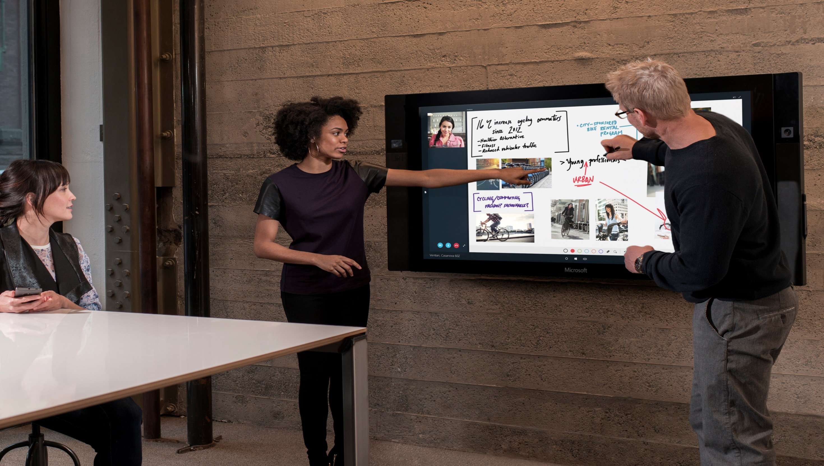
A MODERN
Felsőoktatás és a közösségi hálózatok
Orbán Bence – Office PMM, Microsoft
Notes:
Slide Objective: Introduce “reinventing Productivity”, explain the focus on the commercial cloud, and how Office 365 and the Enterprise Mobility Suite have evolved to meet current customer needs. Preview presentation content.
Set expectations that this presentation is designed to engage the audience in a conversation about the changing work and business landscape and how Microsoft is not only keeping pace with the changes, but investing into the future to anticipate and take advantage of them.
In the presentation we disclose high-level areas of focus, as well as longer term investments. We will also have a look at our most recent future vision video that gives you a glimpse of what life could look like in 5+ years.
And, we’ll spend some time “unpacking” the video, exploring some of the key scenarios and aligning them to technologies and services we already have available today that are stepping stones to this future.

Slide 2

A MODERN DIÁK
Mindig mobil, mindig mozgásban van
Csapatban dolgozik és kommunikál
Közösségi hálózatokon nőtt fel
Több eszköze van (okostelefon, tablet, laptop)
Készség szinten használja a technológiát
Notes:
Slide Objective: Use a millennial example to create a sense of urgency for change.
Today’s graduates and those in school—millennials—paint a vivid picture of what it looks like to thrive in the mobile-first, cloud-first world. By 2020, this is the generation that will make up the majority of the workforce. Staying still and maintaining the status quo is not an option.
These young men and women have grown up not knowing a world without social networks
That has changed how they relate to each other—how they interact.
They approach collaboration and sharing very differently. They are much more inclined to put an early spark of an idea out there and crowd-source the process of iteration.
That is in contrast to the behavior of the past where knowledge was power, it was hoarded, protected, and not necessarily shared willingly.
Not only have millennials always had social networks, the impact of pervasive connectivity and the explosion of devices has changed the way that they communicate and relate to each other. Fleeting messages on Snapchat and group chats on WhatsApp have replaced email and instant messaging as their tools of choice and they expect their conversations to follow them no matter what device they are using.
It's not enough to have the tools that we've had for the last couple of decades. We have to empower everybody in organizations to drive the greatest impact that they can.
To succeed we must reinvent productivity and this means we must rethink the way we make technology, not simply make more of it. One key way in how we rethink productivity is to leverage our understanding of the importance of working like a network, building tools that empower social productivity and communications.

Slide 3
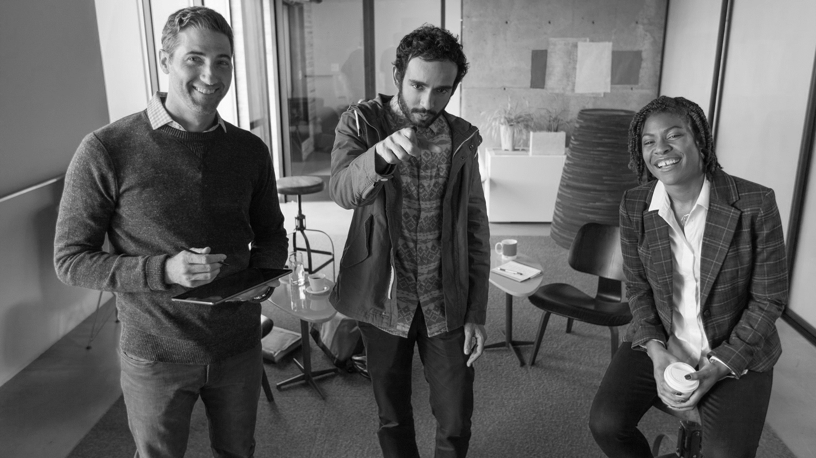

Miért a Yammer?
Információ gyűjtés és megosztás
Minden személy, dokumentum, szervezeti egység egy helyen található
Nincsenek többé szervezeti „silók”
Online, közösségi „archívum”
Notes:
Jah, te azt nem kaptad meg? Elfelejtettelek betenni a levélbe?
Van valami anyagod ebben-abban a témában?

Slide 4


Nem-Rutin Munka
40%
25%
1900
2010
2015
Source: http://www.gartner.com/newsroom/id/1416513
Notes:
We built companies primarily for people to do routine work, which doesn’t require judgment and creativity
As we can see from this Gartner study, the amount of non-routine work is rising dramatically and continues to rise
A Gartner Strategic Planning Assumption is that by 2015, 40% or more of enterprise work will be "non-routine," up from 25% in 2010
In the beginning, I talked about how there are diminishing returns with new technology
This chart hints at why because we were primarily using technology to optimize for the old way of working
Automation – Technology has helped us automate all of the routine work
As work becomes increasingly non-routine, people need better information to make decisions
So let’s look at how information travels within companies

Slide 5
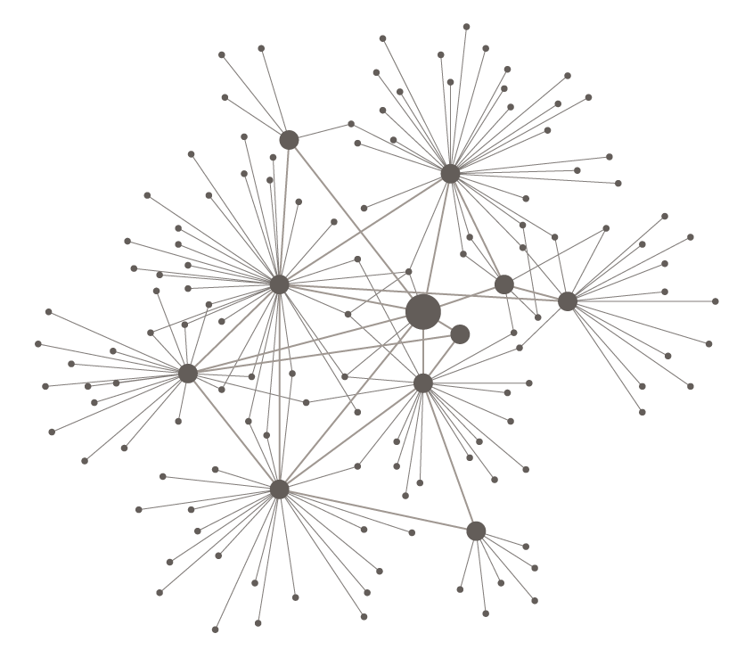
TRADÍCIONÁLIS HIERARCHIA
RESZPONZÍV HÁLÓZATOK
LASSÚ INFORMÁCIÓ ÁRAMLÁS „OSZD MEG ÉS URALKODJ”
GYORS, 360 FOKOS INFORMÁCIÓ TANUL ÉS ALKALMAZKODIK
Notes:
Slide objective: Give context on the speed of growth of social networks.
Socially networked communications are rapidly taking over as a more effective way of exchanging information in the modern world. One recent study estimates that enterprise social platform usage will grow from 208 million users in 2013 to 535 million in 2018 (2).
So what’s driving this growth? Because Networks are open and transparent by nature, they help unlock the tacit knowledge of employees and create shared intent. This accelerates innovation, responsiveness, problem solving and learning. People feel more productive (1) and information flows faster and is more likely to reach the right people through networks than through hierarchical and point to point communication structures
This change in communication tools is putting massive stress on existing hierarchical organizational structures. Built to control information flow, they suddenly need to accommodate networks that are more open and transparent, and assume that decisions are made at the edges.
Optional Example:
One of the most hierarchical organization around, the US army, even recognized the power of this: General McChrystal, in Iraq and Afghanistan, realized they were a hierarchy fighting a network. To fight a network, they had to think like a network. They went from a need to know basis to a need not to know basis with their communications. Suddenly, they were reaching all kinds of people in their own troops who were reaching back and helping them, people they wouldn't have ever thought to reach out to. Most importantly: they built trust and aligned purpose amongst the troops that let to highly effective shared consciousness. As a result, the organization was able to make decisions faster and function at a much higher level.
Sources:
(1) Nearly 50 percent of employees at both SMBs and large companies indicated that using enterprise social tools has increased their productivity.
http://www.microsoft.com/enterprise/en-sg/it-trends/social-enterprise/articles/enterprise-social-adoption-trends-across-smbs-and-large-companies.aspx#fbid=aT1mOsNIeBb
(2)“… the total number of full-suite enterprise social platform subscribers is expected to go up from 208 million in 2013 to 535 million in 2018. Currently, there are about 2 billion workers worldwide who could benefit from enterprise social technologies across numerous industries, organizations, locations and job roles.” http://www.frost.com/prod/servlet/press-release.pag?docid=289562565
http://foreignpolicy.com/2011/02/21/it-takes-a-network/
http://mcchrystalgroup.com/insights/

Slide 6

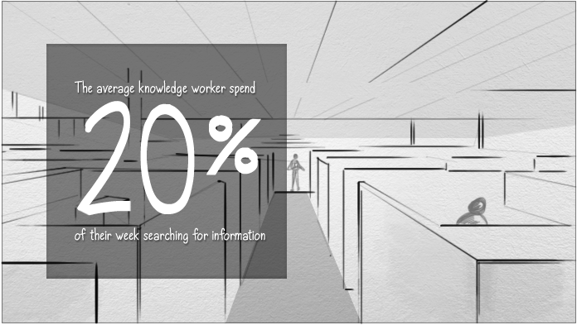






FELKÉSZÜLT ERRE A FELSŐOKTATÁSI KULTÚRA?
Notes:
Now think about your business organization: are your employees as connected and networked as the rest of the world? Are they able to communicate easily with team members? Do they have the information they need to do their jobs, right at their fingertips?
[CLICK]
Chances are, geographic, functional and information silos continue to create internal barriers. Things get stuck in unconnected systems and broken communication channels, slowing down the pace of information. At the same time, the rise of a distributed and mobile workforce further reinforces these silos. For instance:
Remote work increased to 80% from 2005 to 2012 (Global Workplace Analytics, 2013)
29% of global workforce is remote or mobile, with more than 3 devices (Forrester, 2013)
These broader trends combine to make companies—and the employees who work for them—more fragmented while the rest of the world is breaking down barriers in unprecedented ways.

Slide 7
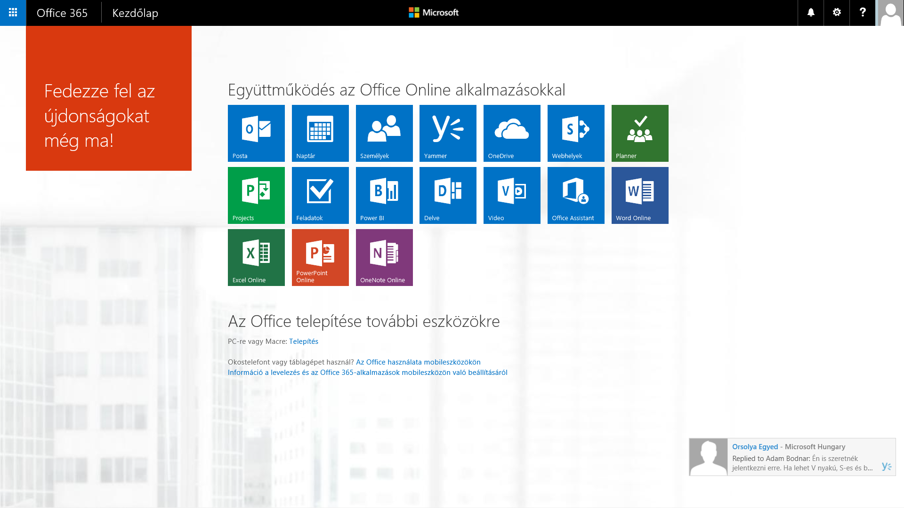

Slide 8
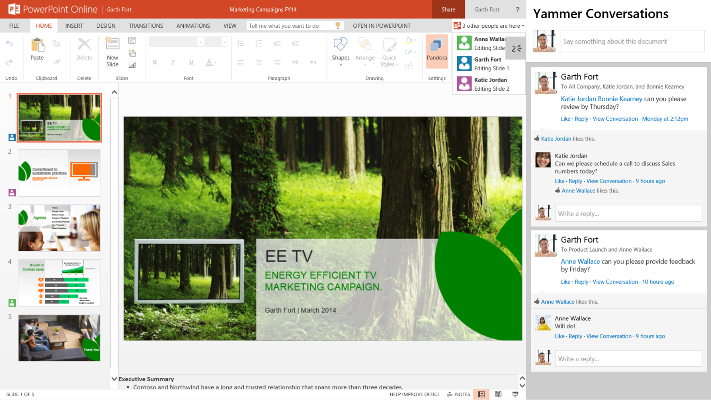
Yammer integráció az Office 365 - ben
Privát, biztonságos közösségi hálózat felsőoktatási intézmények, vállalatok részére
Integráció az Office online alkalmazásaival a közösségi szerkesztés, postok, frissítések jegyében
SharePoint alapú adattárolás a központi elérés és közösségi szinkronizáció érdekében

Slide 9
Telefonhívás
Skype for Business konferencia és valós idejű együttműködés
Széleskörű információ-megosztás a vállalati közösségen belül (Yammer)
Skype for Business
Információtovábbítás sebessége
e-Mail
Csoportok
OneDrive
SharePoint Site
Vállalati intranet
Érintettek száma

Slide 10
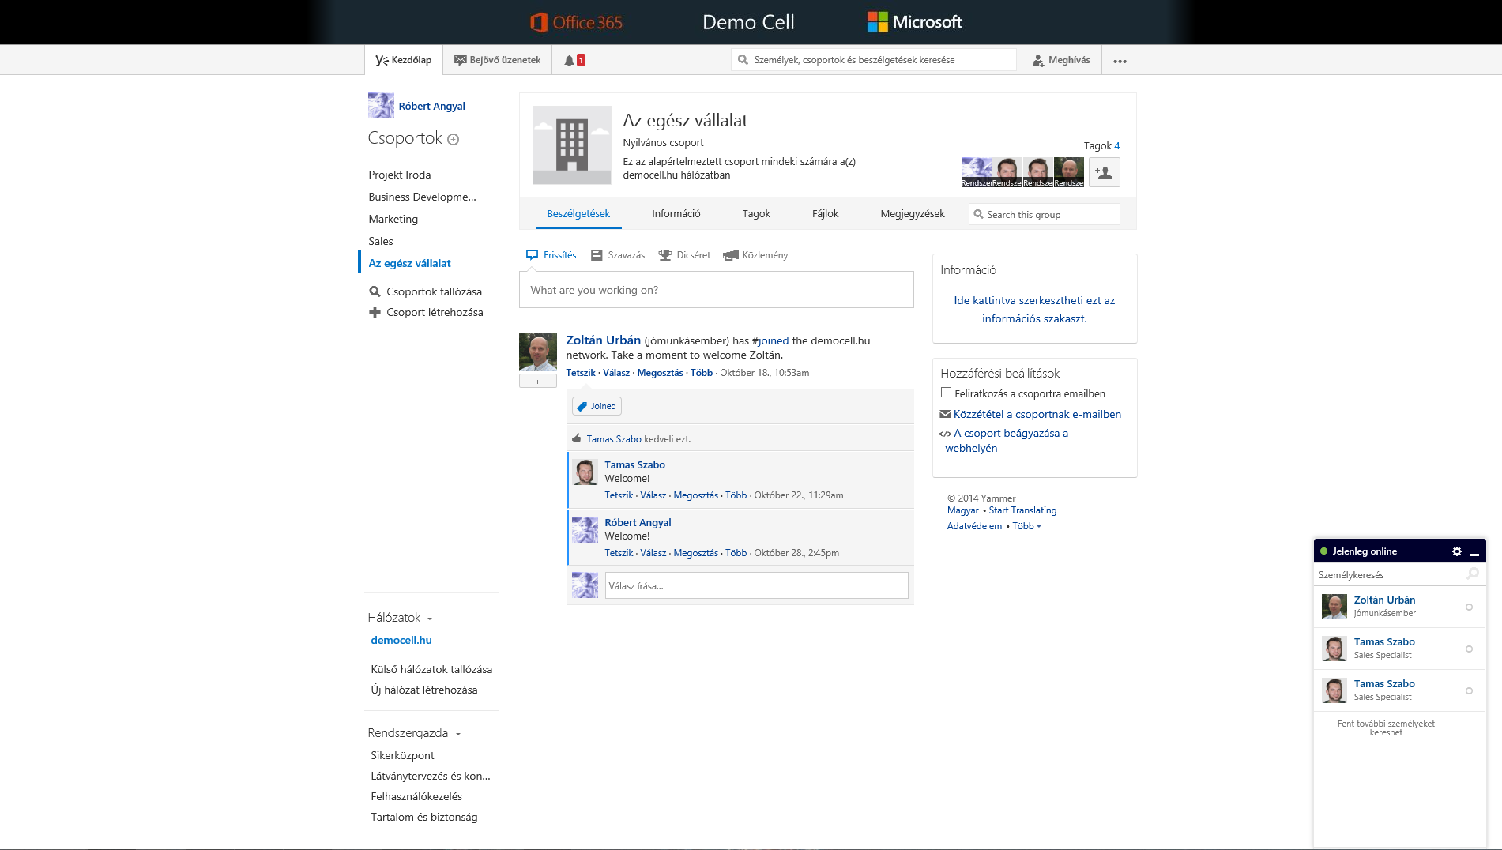
Kezdőlapra kattintással megtekinthetők a teljes hírfolyam
A bejövő üzenetekre kattintva láthatók a minket érintő bejegyzések
A harangra kattintva az értesítéseinket tekinthetjük meg
A keresőből a teljes Yammer-en kereshet, bejegyzésekre, fájlokra, csoportokra, emberekre…
Kattintson további lehetőségekért (profil beállítások, aktivitások teljes listája)
A névre kattintással megtekinthetők az aktivitások
Csoport információk
Láthatja azokat a csoportokat, melyekhez csatlakozott, itt értesülhet arról is, hogy melyik csoportban hány olvasatlan bejegyzés keletkezett
Egy kattintással meghívhatja kollégáit a Yammer vállalati hálózatba (jogosultság esetén)
Hívjon meg a csoportba további tagokat
Létrehozhat csoportokat, ahová meghívhatja kollégáit és azonnal rendelkezésre áll a felület a csoportmunkára
Kezdeményezhet csevegést a Yammer felületéről
Osszon meg információt, képet, dicséretet, dokumentumot, vagy indítson egy szavazást egy kattintással
Láthatja azokat a hálózatokat, melyekhez csatlakozott, illetve itt válthat az egyes hálózatok között
Rendszergazdaként további adminisztrációs és beállítási lehetőségek állnak rendelkezésre
Tekintse meg a csoporton belüli bejegyzéseket, megosztásokat. Követhet beszélgetéseket, témákat, dokumentumokat és embereket

Slide 11
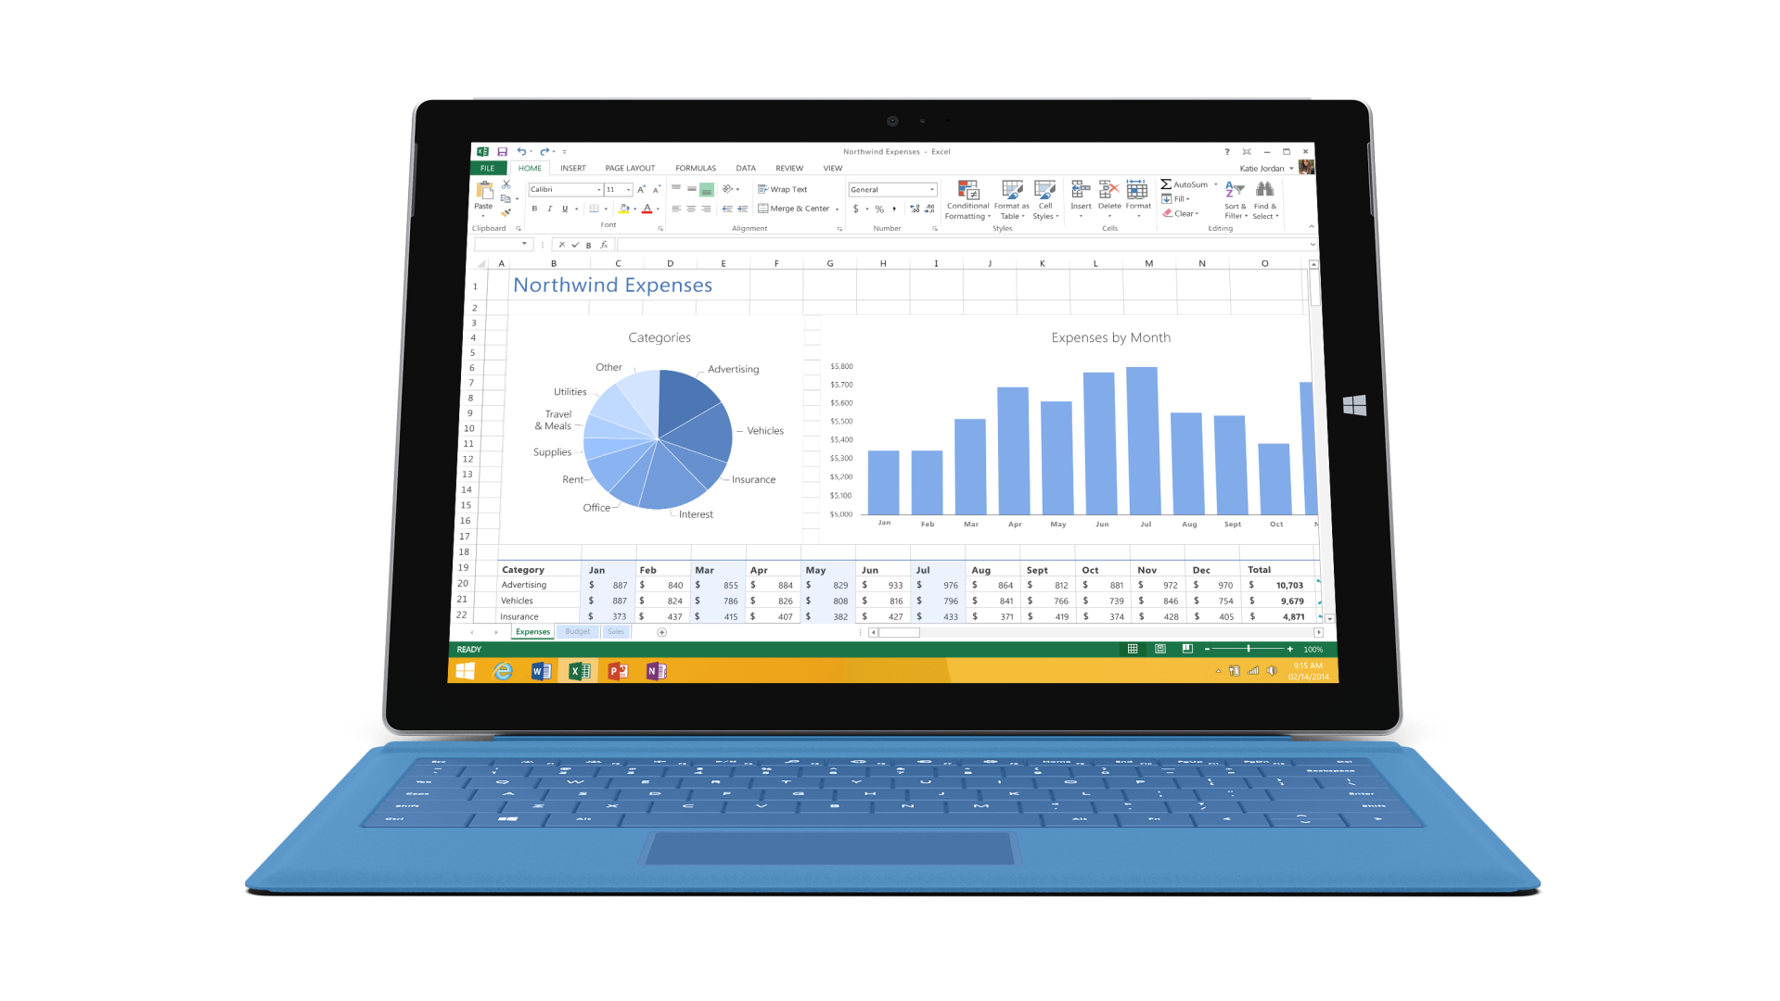
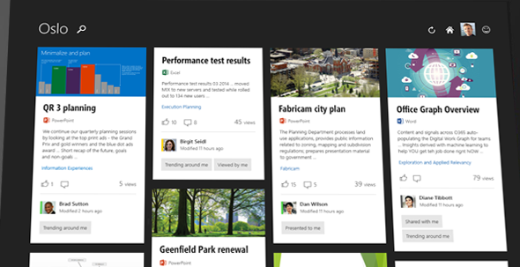
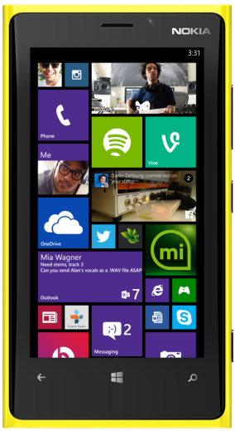

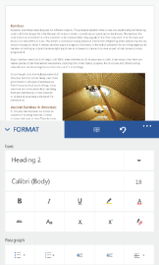
DELVE
Machine Learning alapú kereső algoritmus (Office Graph), teljes Office 365 integrációval
Intelligens kapcsolati háló a felhasználók, dokumentumok, szolgáltatások (így a Yammer is) között
Multiplatform szolgáltatás – Windows, Mac, iOS, Android

Slide 12



